Slide 1
Deadtime compensation:
Internal Model Control

Slide 2
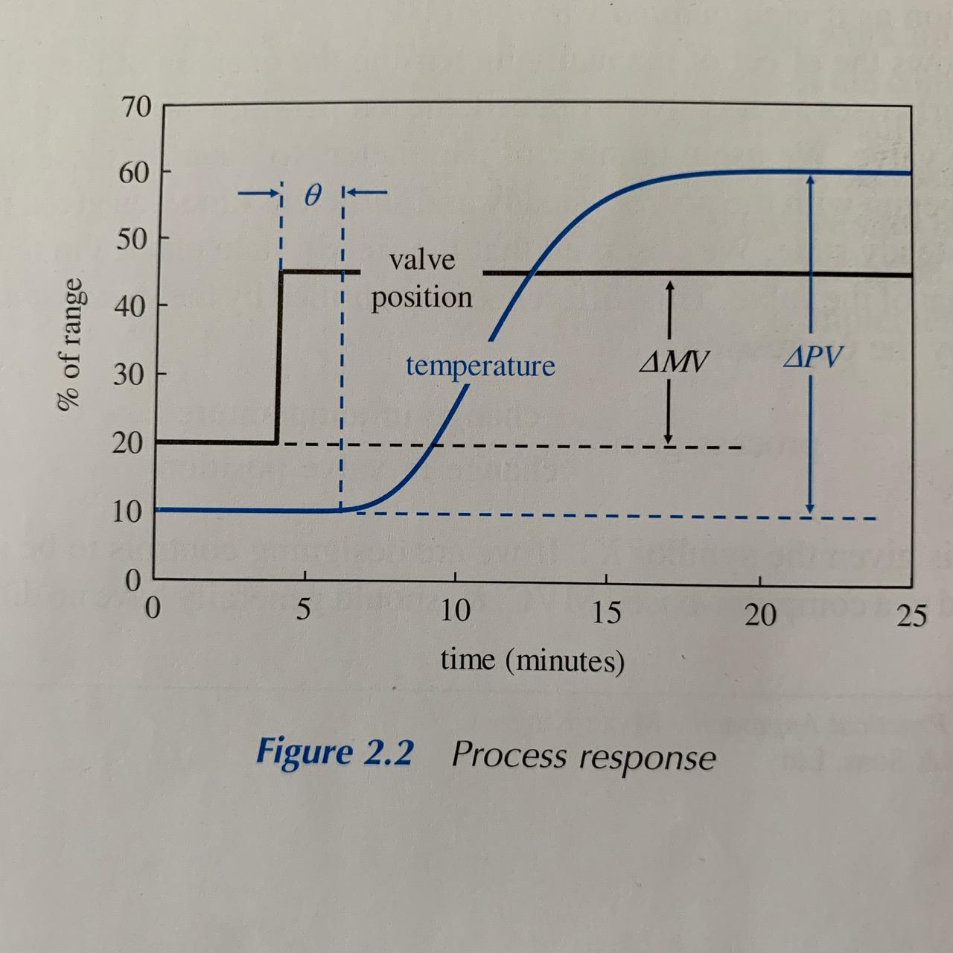
Deadtime
caused by transform delays (e.g. time it takes for the heated fluid to move from firebox to the temperature instrument)
possibility of lag (delay between detection of a an increase in process variable)
deadtime / lag ratio increases -> reduce the controller gain to maintain stability
controller may respond slowly
deviations from desired condition
to overcome this problem, we
rely on estimates of the process
dynamics

Slide 3
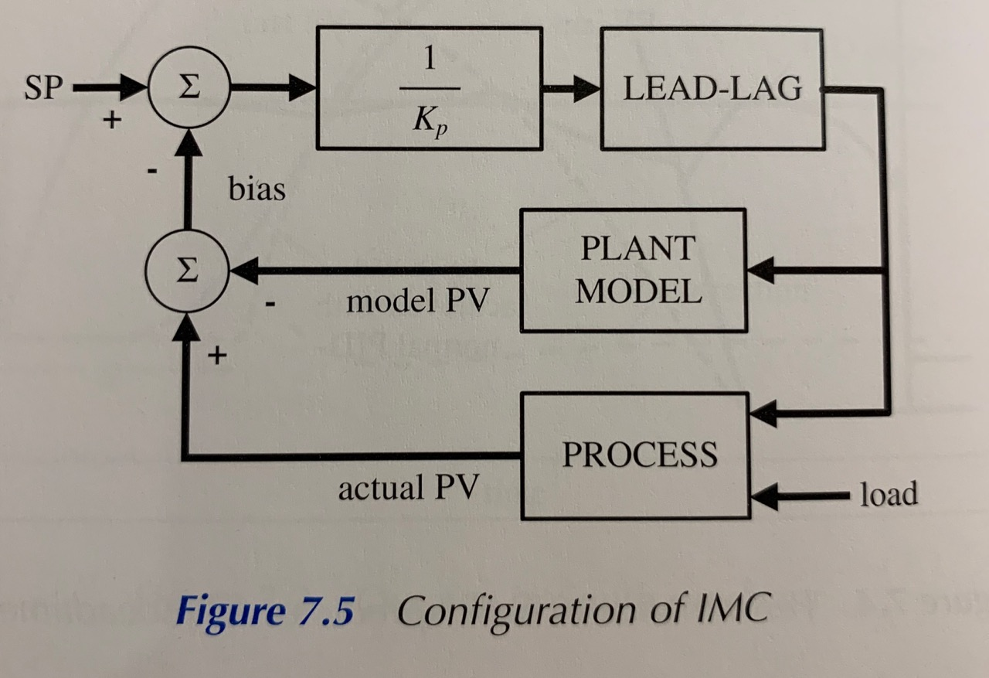
Internal Model Control (IMC)
replaces PID controller completely
same approach as tuning PID controller using the IMC tuning method (if no deadtime)
with deadtime - IMC >>> IMC tuning in a PID controller
Notes:
Internal Model Control (IMC) replaces PID controller completely. Its name derives from the fact that it can be shown that it is effectively the same approach as tuning PID controller using the IMC tuning method. However, this is only exactly true if there is no deadtime. With deadtime IMC will outperform IMC tuning in a PID controller.
Figure shows a configuration of IMC. Any changes in desired condition are divided by the process gain (Kp) and pass via a lead-lag algorithm to the process. The lead term (T1) is set to the process lag. The lag term (T2) is configured to give the desired controller response. If set equal to the process lag then the change is sent to the process as a step. The process variable (PV) will then approach desired condition (SP) with a time constant equal to the open loop process lag (tau).

